Slide 1
PC^2 Web Team Interface (WTI)
Josie Isaacson, Andrew Combs, Ethan Holman, Danielle Frodge

Slide 2
Overall Objective of WTI
Our objective is to provide a single web-based interface that maintains the functionality of the current Version 9 (V9) Application Team Client while replacing functionality from the V9 EWTeam Web Client and the Version 10 (V10) Team Client.
The purpose of this interface is to allow for more efficient contest set up by not requiring individual installation on each team machine.

Slide 3
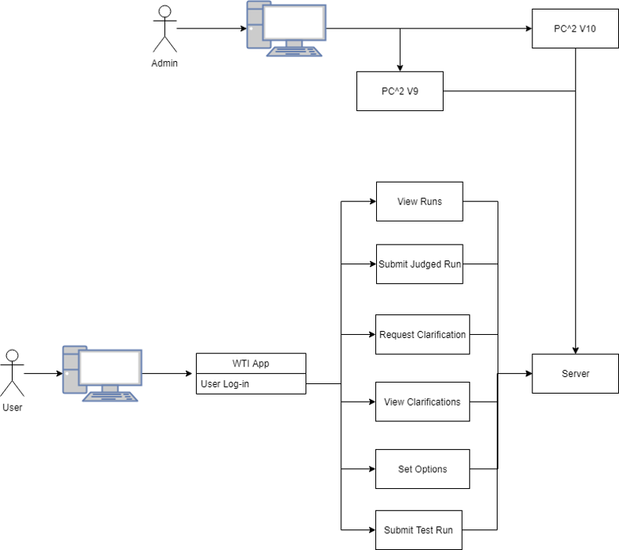
Functionality
Basic system functionality of WTI
V9 and V10 will communicate to server
Jersey
Websockets (sln. to polling)
Rest points
Swagger

Slide 4

Features
Team Login
Submit Judged Run
Submit Test Run
View Runs
Request Clarification
View Clarifications
Set Options

Slide 5
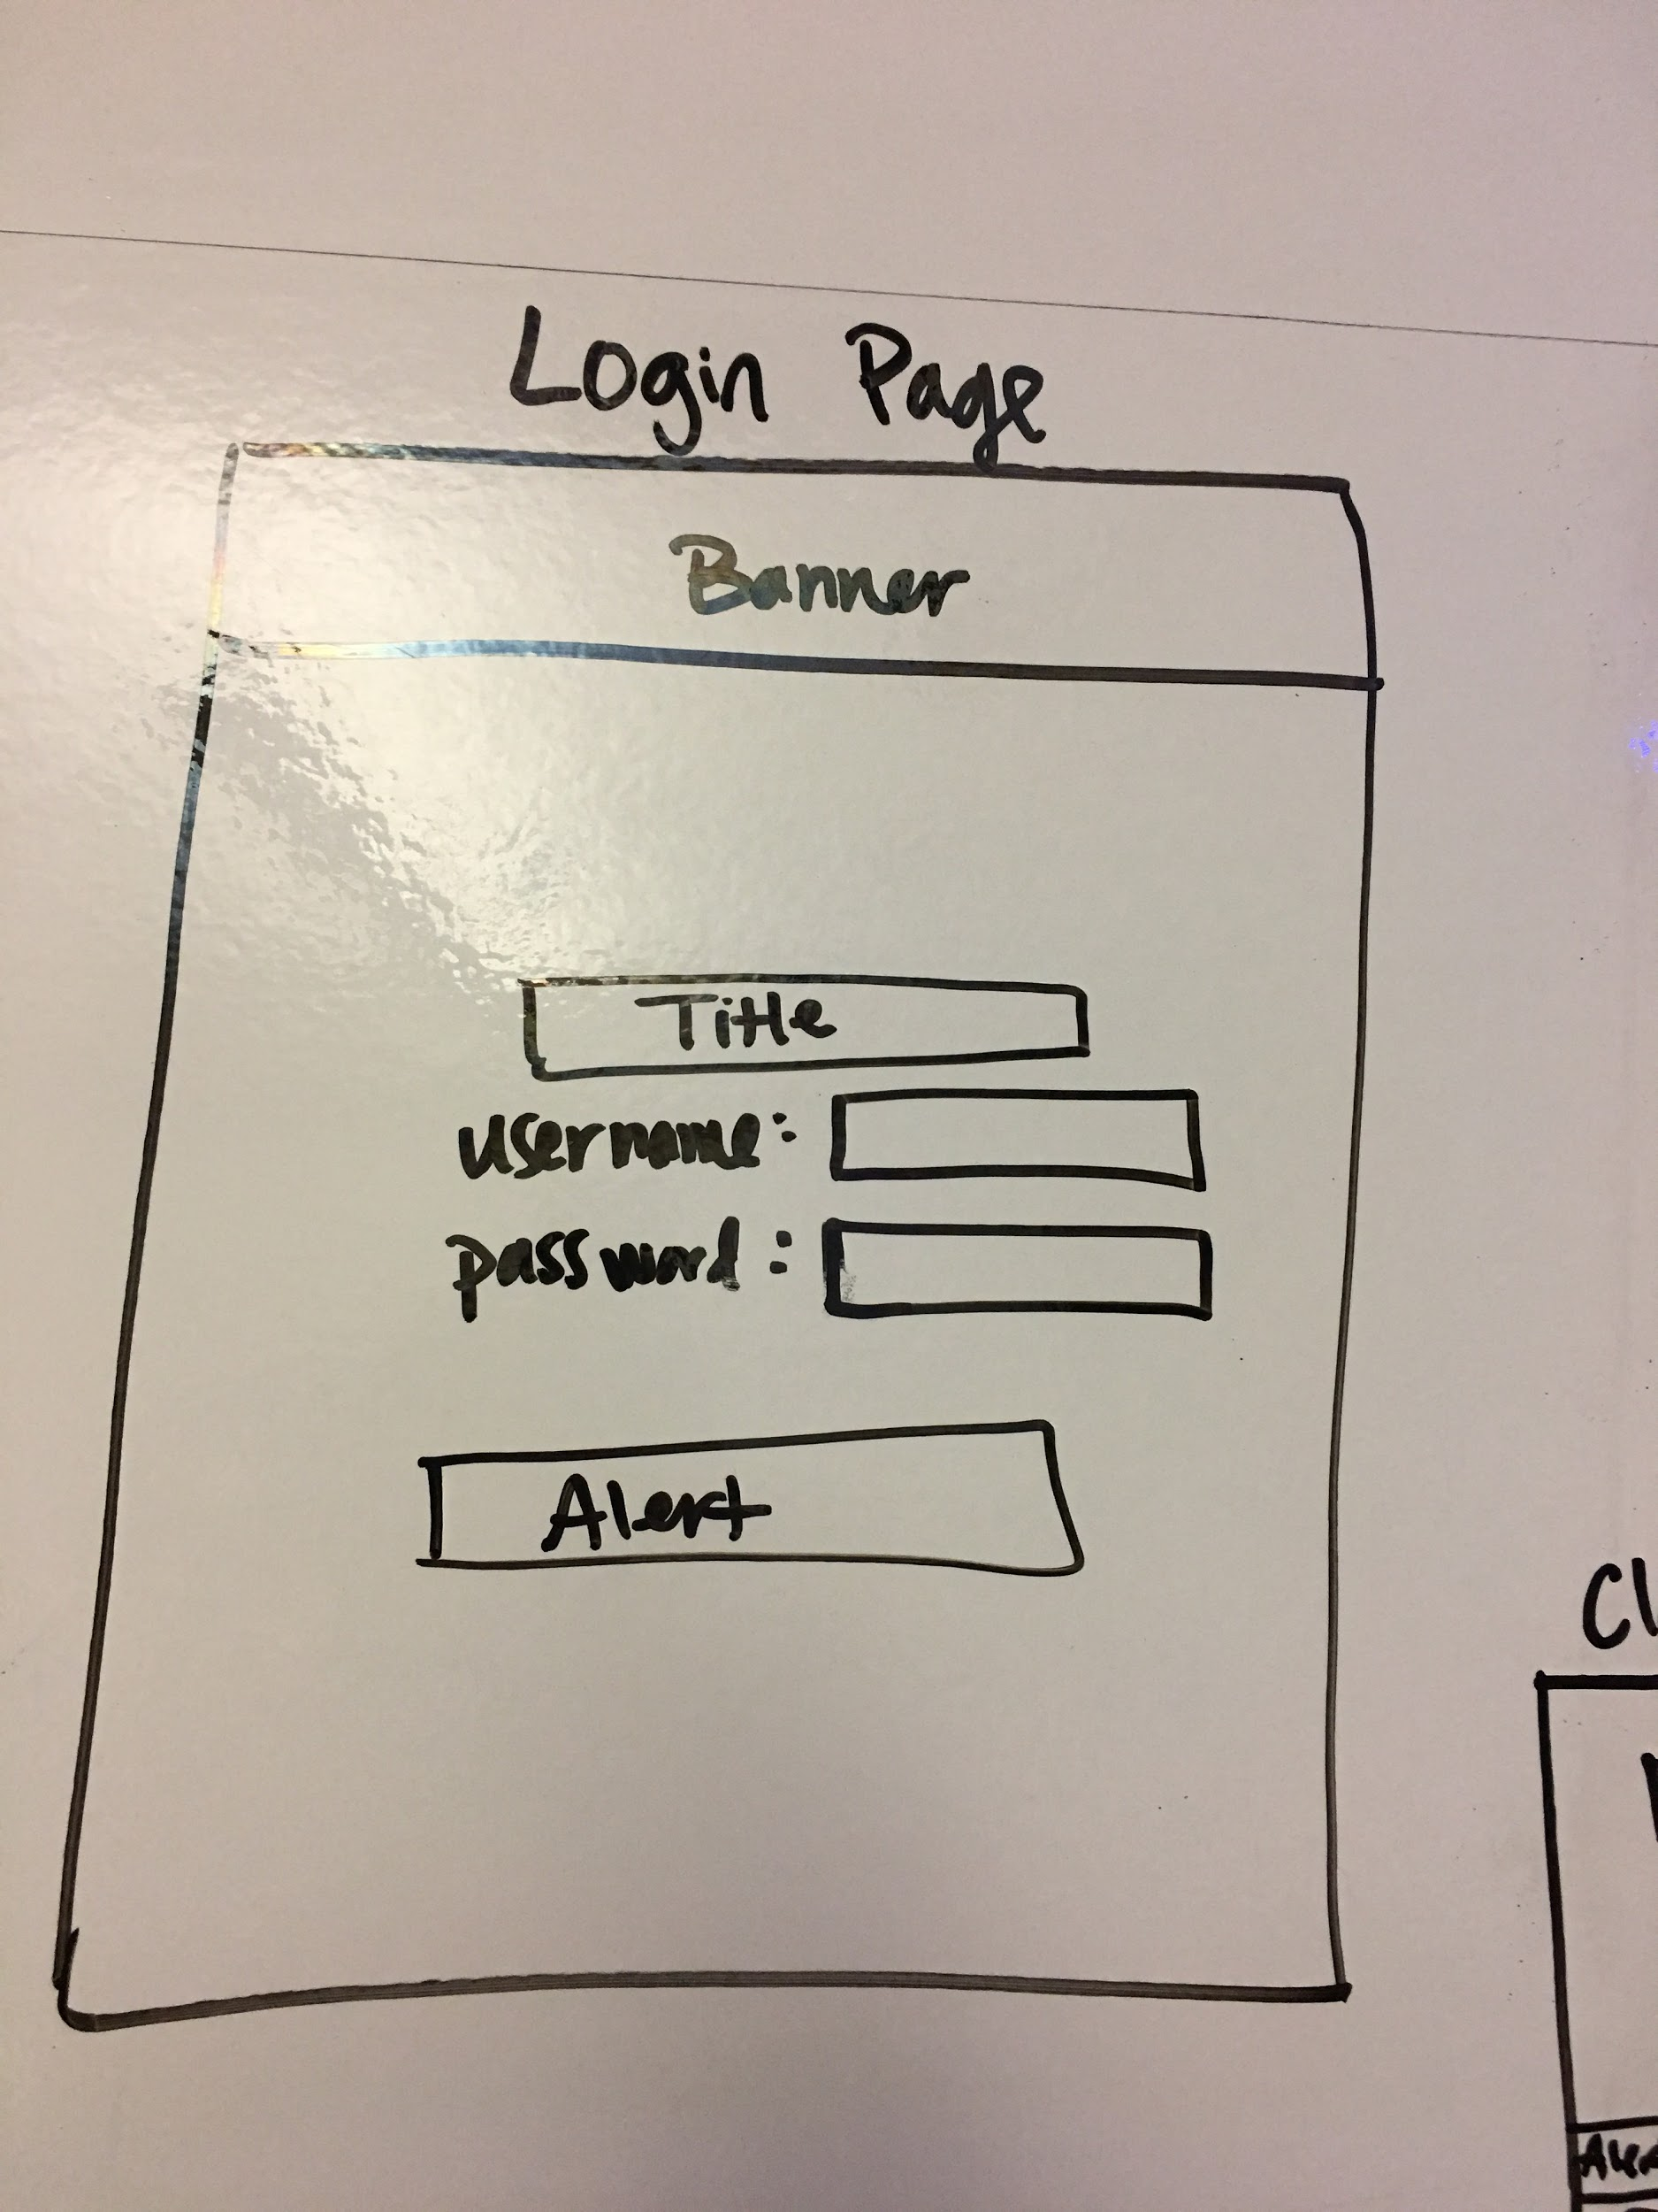
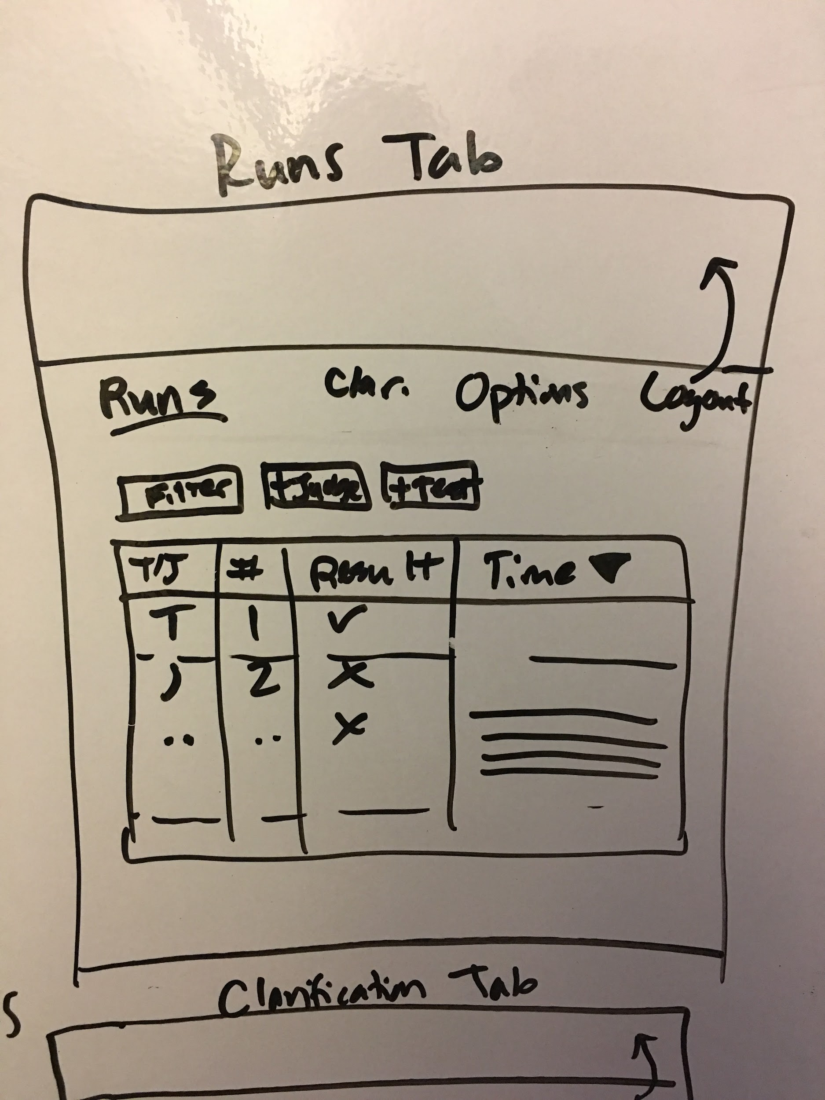
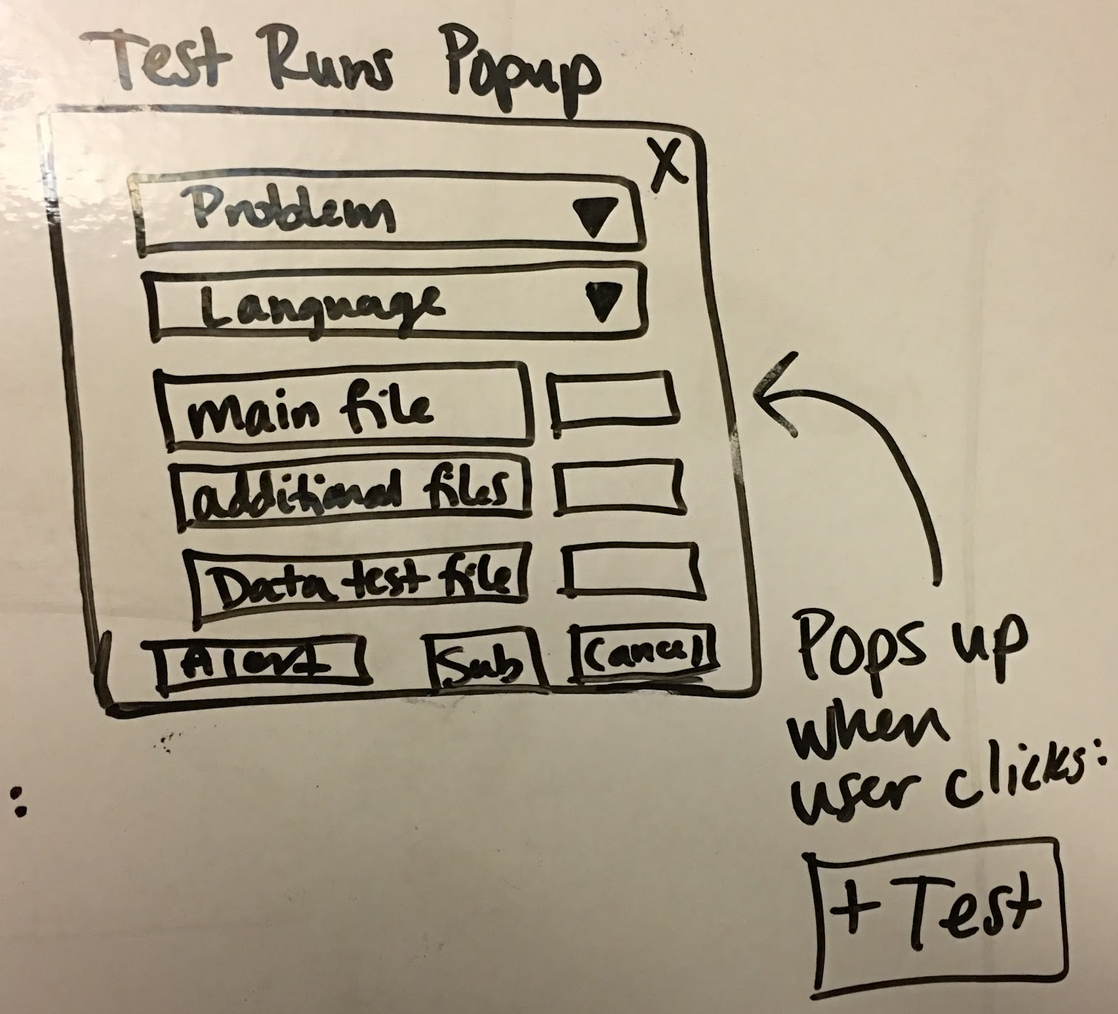
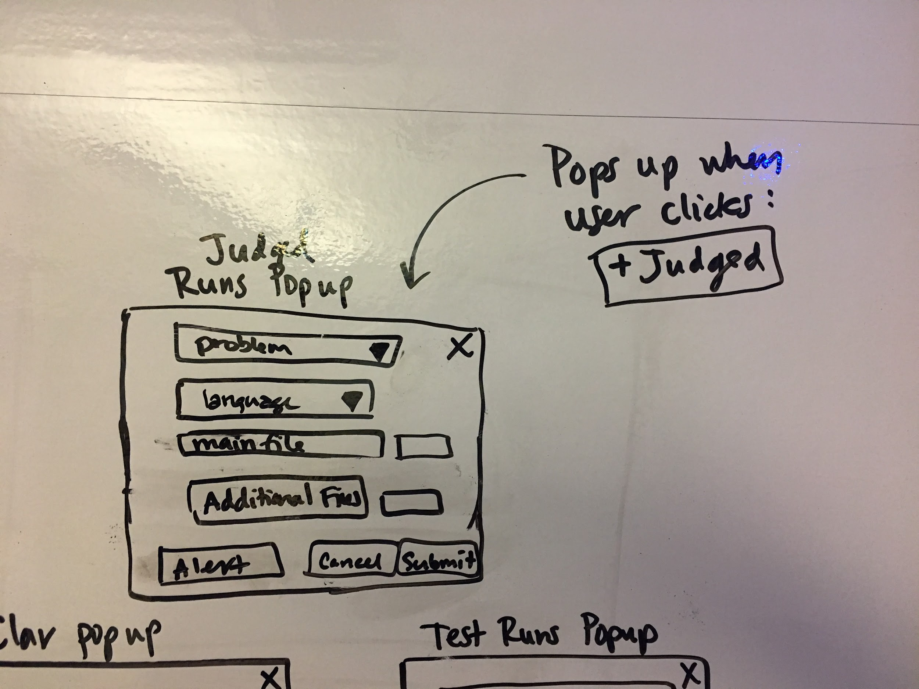
Initial Design Concepts

Slide 6
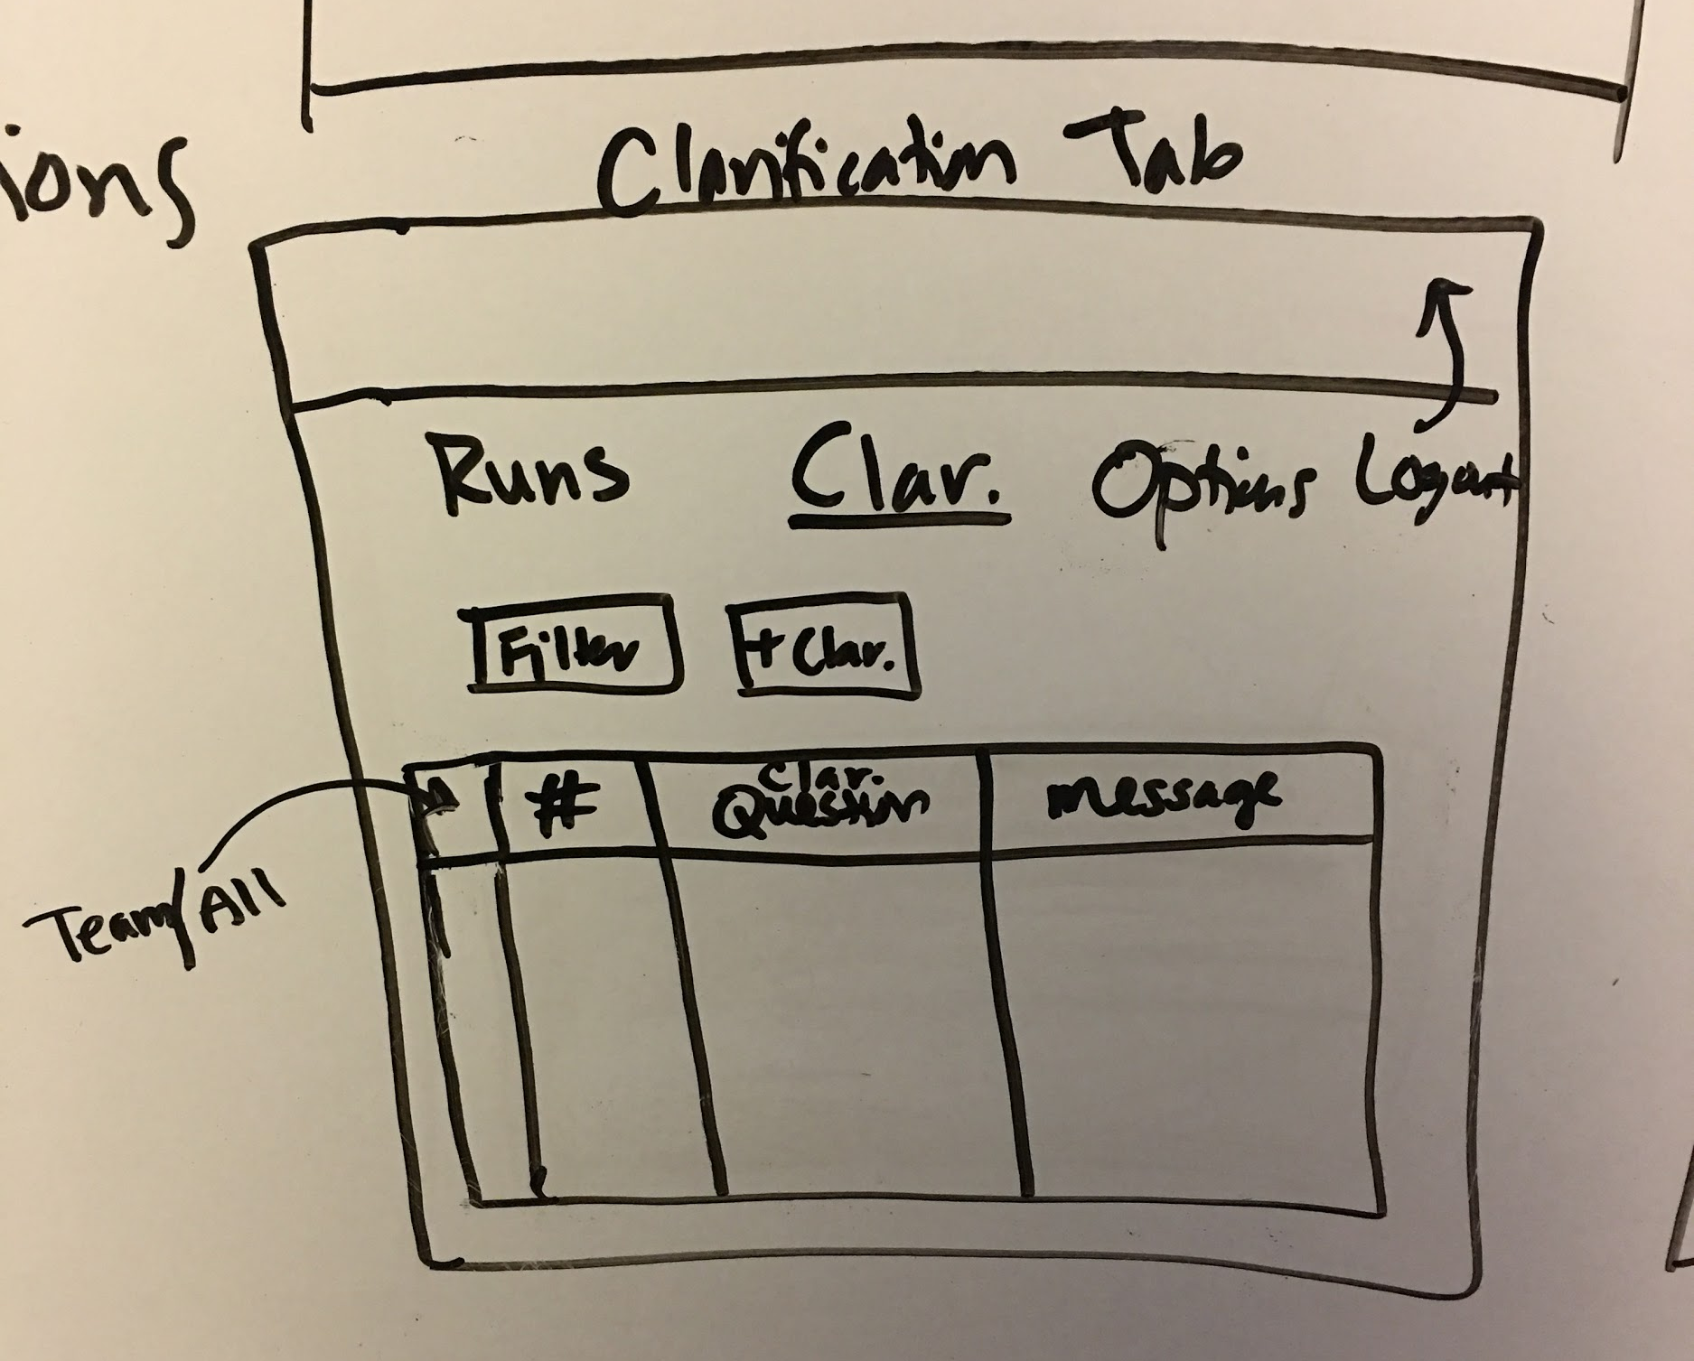
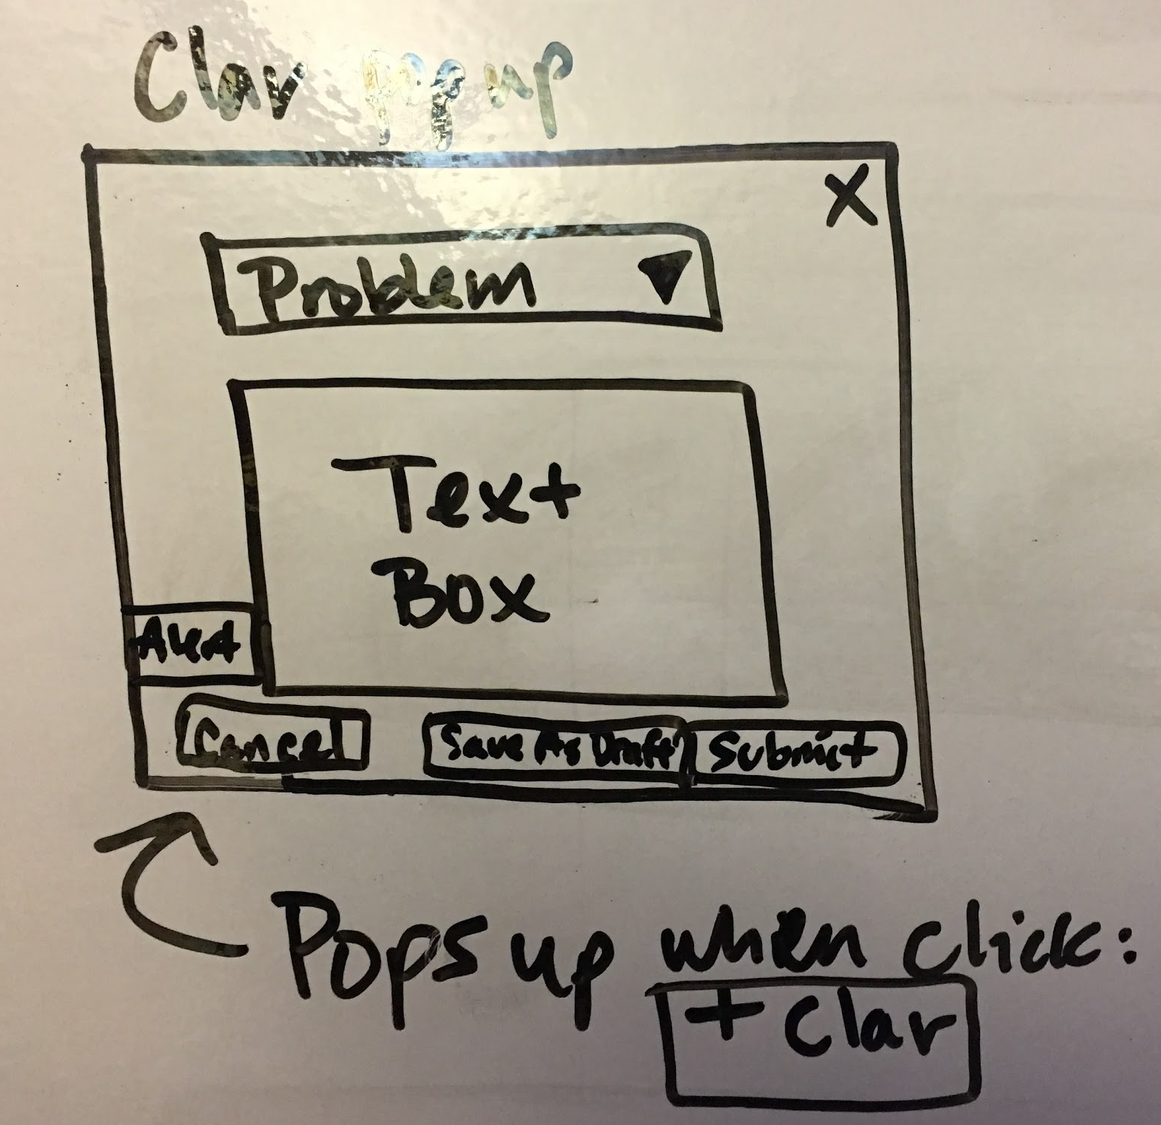
Initial Design Concepts

Slide 7
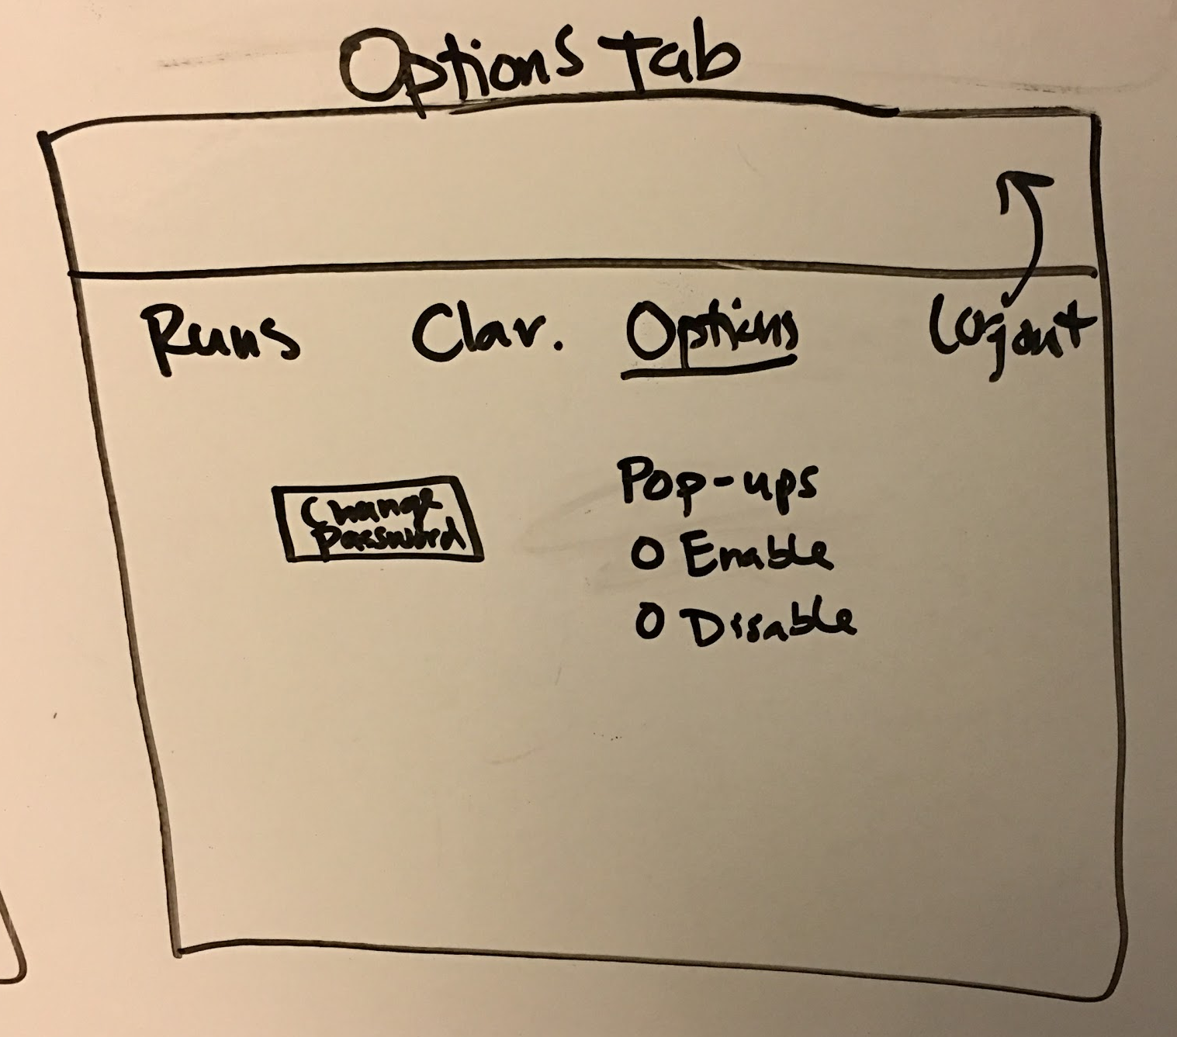
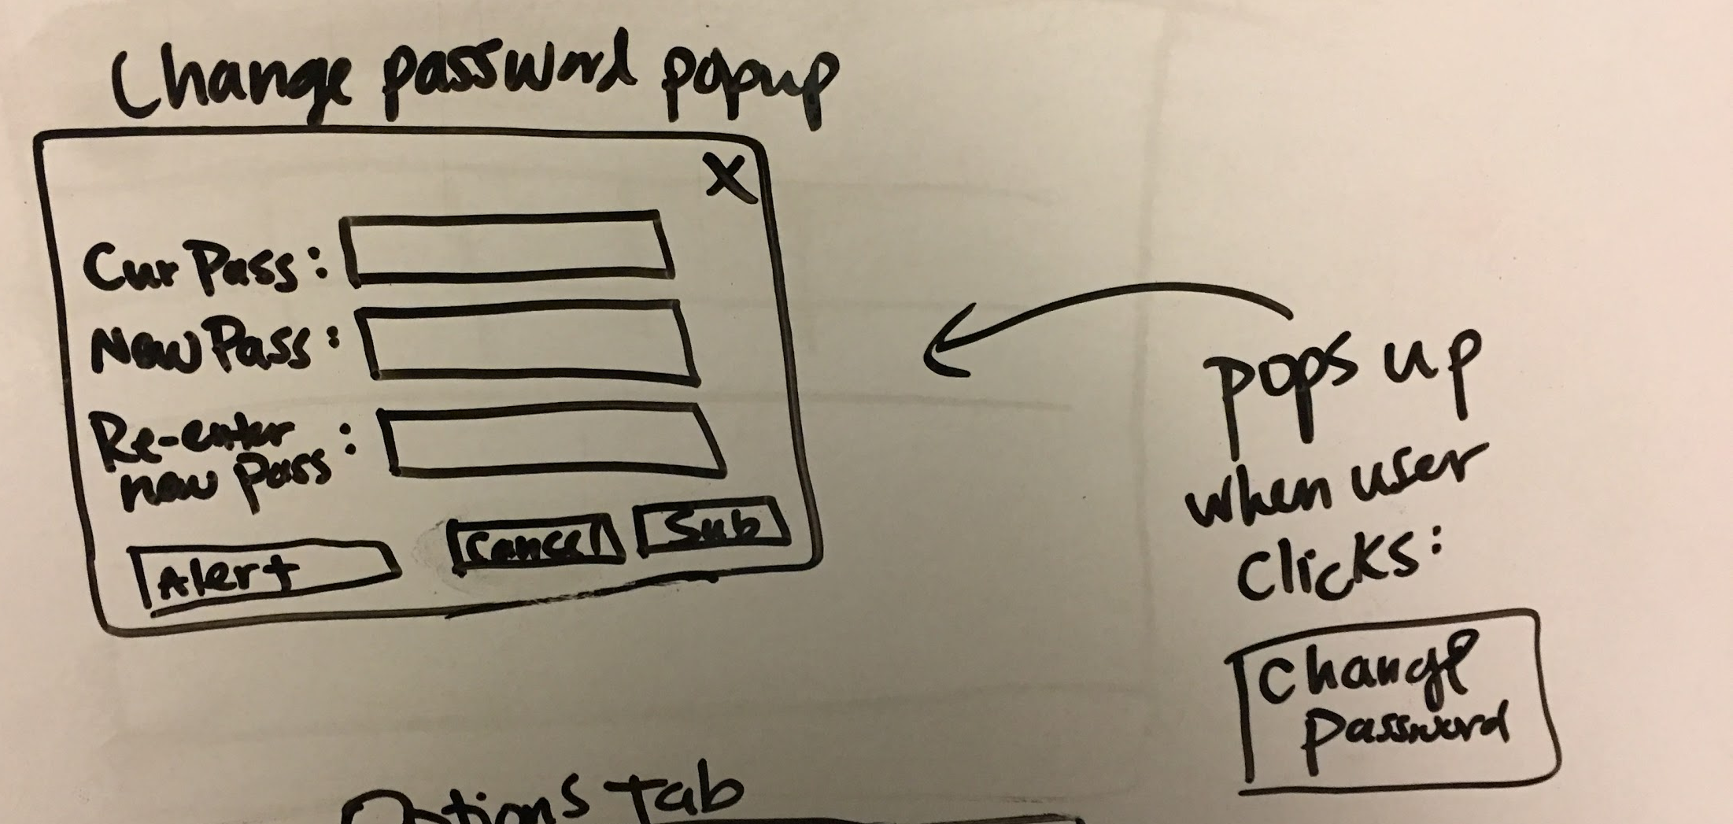
Initial Design Concepts

Slide 8
Formal Mockups Using Figma
DEMO API, Swagger
Sprint 1 Review

